Slide 1

Texas Crash Report
Presented by Latrice Puckett

Slide 2
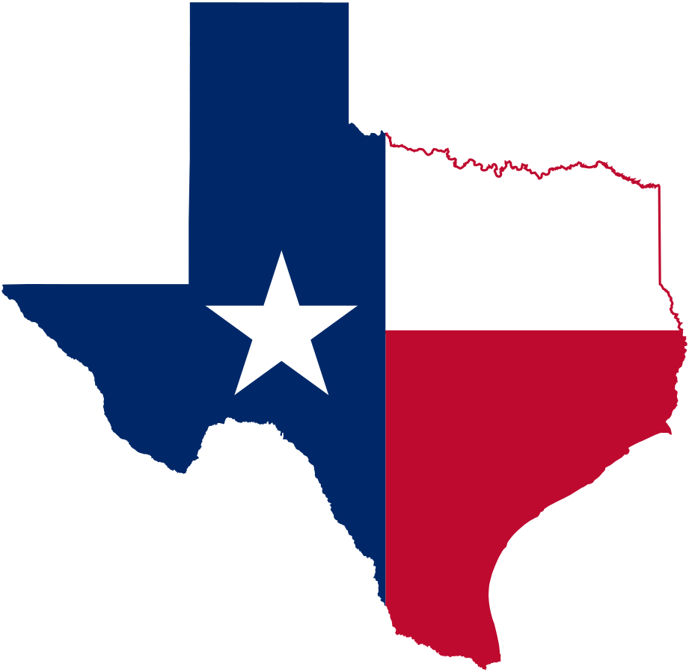
Good ol’ Texas, USA
Texas is known for doing things bigger. They pride themselves on being a large and in charge state that paves the way for many industries.
But one thing Texas also excels at, is crashing on the roads!
Let’s take a deeper look.

Slide 3
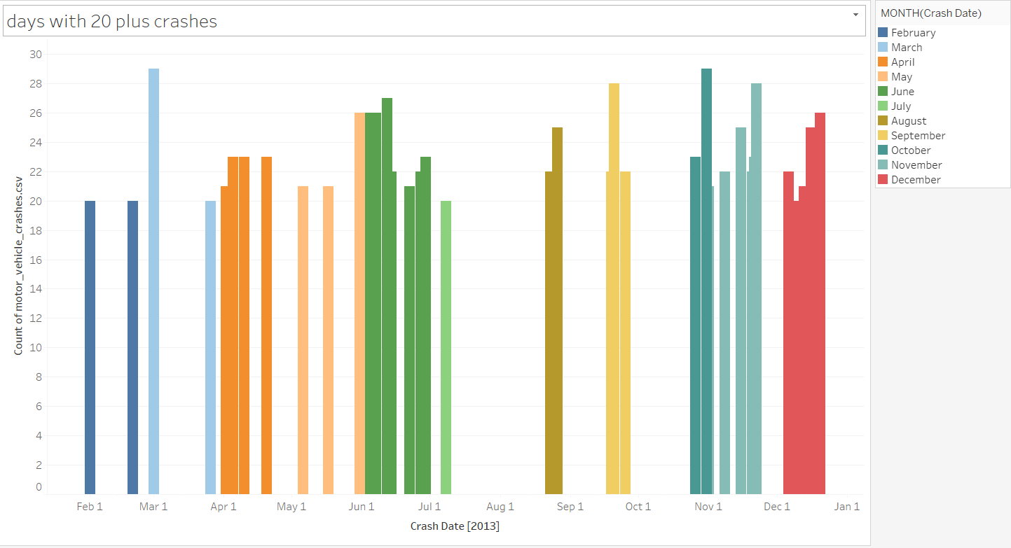
Texas crash data!
So first, we look at all crashes for the year, we see that there is a crash nearly everyday!
Its hard to find any significance in the data, so we will up the ante a bit and look at days where 20 or more crashes happened.
What is shown is that most high-crash days happen in June. Possibly from summer traveling.

Slide 4
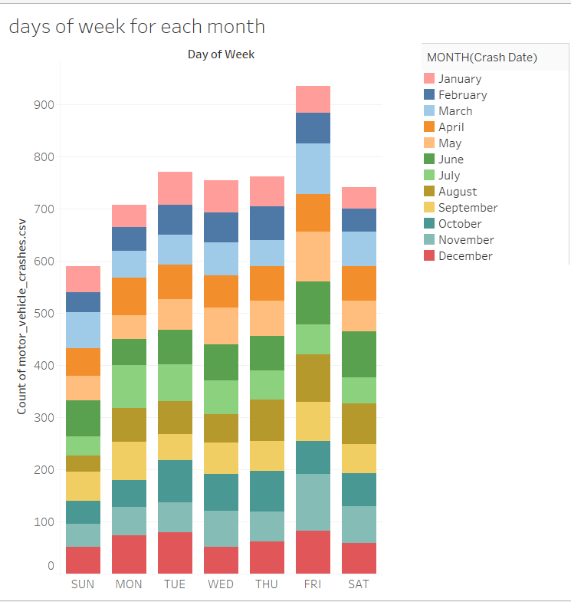
Fridays are for crashing
We can look at days of the week and we see that Friday is the most prominent day that people get into crashes.
The color shows the month for each day of the week, and it seems as if May and November on Friday have the most crashes.

Slide 5
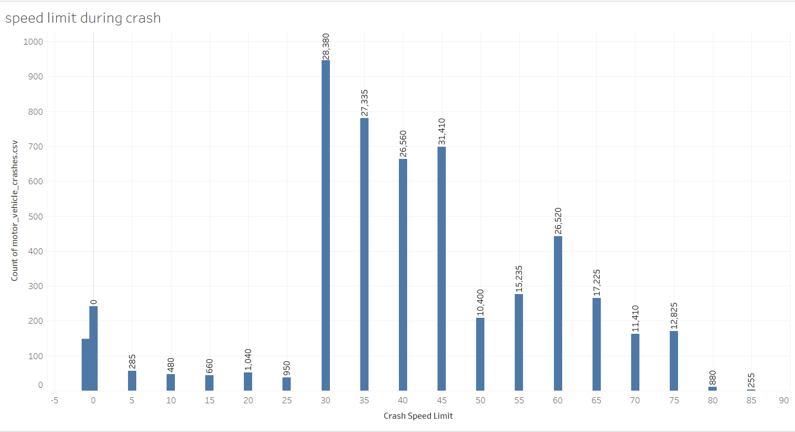
Look both ways before zooming
When we look at the speed of the crashes happening, we find that most occur when the speed limit is 30-45 mph. This could be due to most complex streets having those limits and people ignoring that and other laws.
There is also data on negative and zero speed, perhaps an error in the data entry.

Slide 6
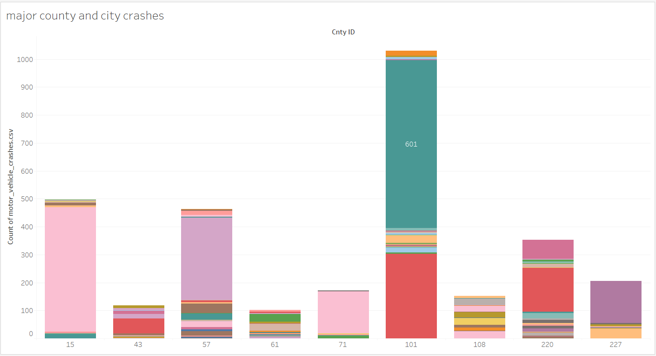
Bright Lights, Big Crashes
It is also important to look at the cities and counties reporting the crashes. Now for this data, the counties and cities are coded with numbers that we do not have access to.
But with the county on the X-axis and the city being color, we can assume that county 101 holds a large city!
The blue color represents 601 crashes for one city. Probably somewhere in central Texas, like Austin, Dallas or Houston.

Slide 7
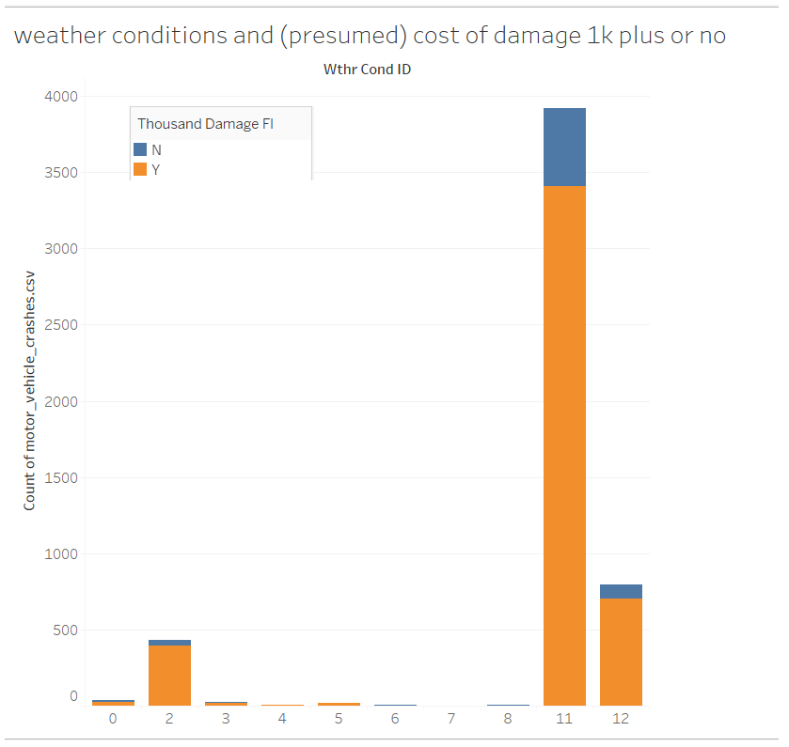
The Cost of the Rain
In this chart we look at weather conditions paired with cost of crash damage being 1,000 dollars or not.
This data is again coded, but my guess is that 11 might be rainy, less than ideal driving conditions, which also resulted in crashes that cost a lot of damage!
We could possibly go a step further and check weather conditions with days of the year and see if it correlates with the rainy seasons. So many possibilities.

Slide 8
Conclusion
With all these data we can better work on Texas’ crashing problem. We now see the days and months that have the most occurrences and can work on advertising safe driving more before and during those months.
We can implement better police coverage for the roads where people are likely to speed, and can have more patrols on Friday!
When it comes to weather we can start with driving education for those conditions, to make sure people are doing the right things and reducing the chances of crashing.
This one year of data has empowered the state of Texas to protect generations to come!

